Slide 1

Group 10
Notes:
ZACK gives brief intro

Slide 2
Members
Android Team
Visual Design: Lucia Martisovitsova, Maurizio Altamura
Level Design: Sam Hyatt, Joel Membribe
Functionality: Chris Fleming, Jordan Pearl
Web & Database Team: Matthew Neidig, Jade Bowyer
Management & Presentation: Zachary Neidig
Notes:
Have every person introduce themselves

Slide 3
Explanation of App
The mobile app is a puzzle game that lets you submit your time taken in a level to the database.
The database stores a user’s device ID, nickname, and information associated with their leaderboard posts (level and time).
The website has a leaderboard, chat, contact information, and an about page.
Notes:
Lucia

Slide 4
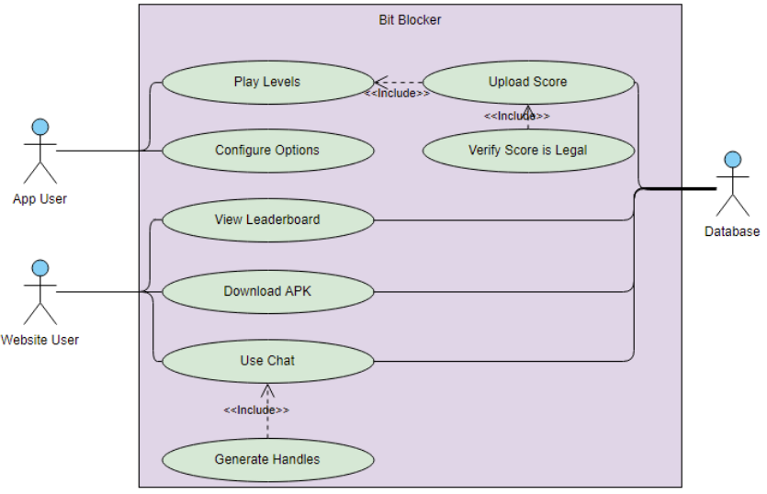
Use Case
Notes:
MAURIZIO

Slide 5
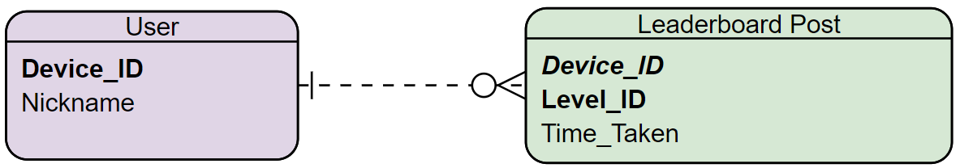
ERD
Notes:
Jordy
Explain how with this setup when a user updates their nickname it will update all of their posts on the leaderboard to their new nickname
Upon starting the app for the first time, the user is prompted to create a nickname. The nickname doesn’t need to be unique because the app will generate a unique device id to go with the nickname. When the user completes a level, their DeviceID and nickname will be compressed into a json along with their level performance and sent to the website’s leaderboard.

Slide 6

Technology Used in the App
The app was developed in Unity (version 2018.2.19f1)
Assets drawn by Lucia and Jordan
Royalty-free music from around the web
Notes:
JOEL Elaborate on how the scripts were written in C#, maybe using Unity with github & other development stuff

Slide 7
Technology Used in the Website
HTML: Layout of web page elements
CSS: Organizing and visual aesthetics
Bootstrap: Prefabs for buttons
Javascript: Functionality for web page
Notes:
JADE: Talk about the bootstrap template used & what you had to do

Slide 8
Technology Used in the Database
Operating System: Linux
Web Server: Apache via AWS Ubuntu EC2
Database Management: MySQL via AWS RDS
Server-side Coding: PHP
Notes:
MATT

Slide 9
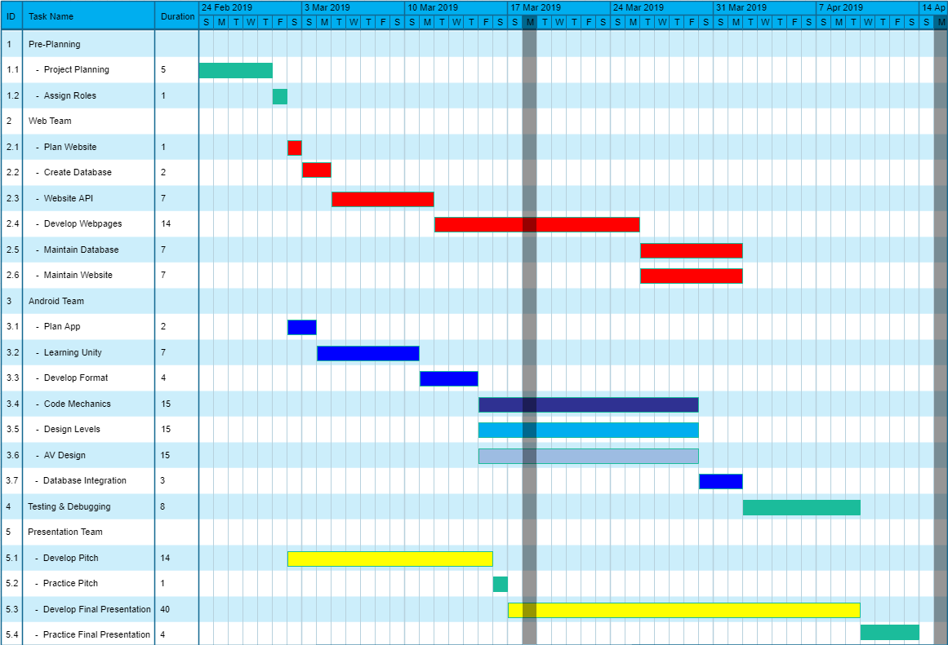
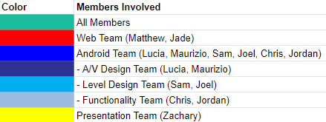
Gantt Chart
Notes:
ZACK

Slide 10
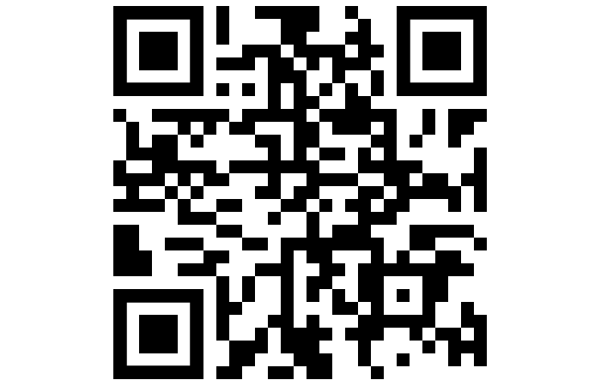
Demonstration and QR Code

